Slide 1
Using Formal Grammars to Predict I/O Behaviors in HPC: The Omnisc’IO Approach
M. Dorier, S. Ibrahim, G. Antoniu and R. Ross, in IEEE Transactions on Parallel and Distributed Systems, vol. 27, no. 8, pp. 2435-2449, Aug. 1 2016.
doi: 10.1109/TPDS.2015.2485980
BLG546E Term Paper Presentation
Tuğrul Yatağan
504161551
Oğuzhan Demir
504161545

Slide 2
Outline
Introduction
The Omnisc'IO Approach
Algorithmic and Technical Description
Evaluation
Related Work
Conclusion

Slide 3
Introduction
The Omnisc'IO Approach
Algorithmic and Technical Description
Evaluation
Related Work
Conclusion
Introduction
HPC applications exhibit periodic behavior, alternating between; computation, communication and I/O phases.
I/O phases produce bursts of activity in the underlying storage system.
I/O optimizations;
Prefetching, caching, and scheduling.
Modeling and predicting spatial and temporal I/O patterns is crucial.
Omnisc’IO;
Approach that builds a grammar-based model of the I/O behavior.
Predicts;
When future I/O operations will occur?
Interarrival time between I/O requests.
Where data will be accessed?
File being accessed as well as the location.
How much data will be accessed?
Offset and size of the data within a file.
Transparently integrated into the POSIX, does not require any modification in applications or higher-level I/O libraries.
Works without any prior knowledge of the application.
Converges to accurate predictions of any N future I/O operations.

Slide 4
Introduction
The Omnisc'IO Approach
Algorithmic and Technical Description
Evaluation
Related Work
Conclusion
Introduction
I/O phases are commonly used for coordinated checkpointing and/or analysis or visualization output.
Effectiveness of prefetching, caching, and scheduling;
Strongly depends on a certain level of knowledge of the I/O access patterns.
Require the location of future accesses (spatial behavior).
Require estimations of I/O requests interarrival time (temporal behavior).
Statistical methods and non-statistical methods based on frequent patterns require a large number of observations to accomplish good prediction.
Statistical models are appropriate mostly for phenomena that exhibit a random behavior.
HPC applications exhibit more deterministic behavior since;
Absence of interactivity with an end-user.
Their code structure.
Formal grammars (models to represent a sequence of symbols) have been widely applied to; text compression, natural language processing, music processing etc.
Formal grammars is also suitable for HPC I/O behavior modeling;
It detects the hierarchical and periodic nature of the code that produced the I/O patterns.
Nested loops and stacks of function calls.

Slide 5
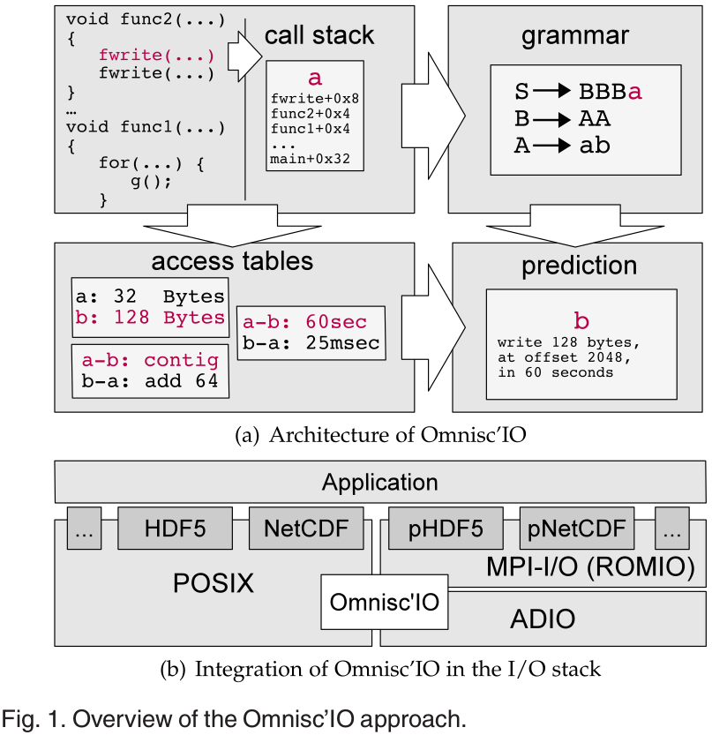
Introduction
The Omnisc'IO Approach
Algorithmic and Technical Description
Evaluation
Related Work
Conclusion
The Omnisc'IO Approach
Omnisc’IO captures each atomic request to the file system (open, close, read, write, etc.) in a transparent manner, without requiring any change in the application or I/O libraries.
The context is extracted by recording the call stack of the program.
A grammar-based model of the stream of context symbols is updated by using StarSequitur a new algorithm derived from Sequitur.
Sequitur has been applied to text compression in the past because of its ability to detect several occurrences of substrings in a text and to store them into grammar rules.
Spatial (size, offset, file) and temporal (interarrival time) access patterns are recorded in tables associating context symbols.
Makes predictions of future context symbols and reduce the grammar in case of periodic behaviors.

Slide 6
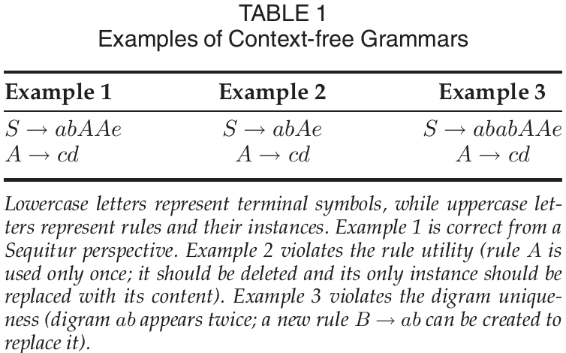
Introduction
The Omnisc'IO Approach
Algorithmic and Technical Description
Evaluation
Related Work
Conclusion
Algorithmic and Technical Description
Tracking Applications Behavior
POSIX I/O functions (write, read...) and the libc functions (fwrite, fread...) are overloaded using a preloaded shared library.
Backtrace retrieves the list of stacked program counters.
Associate the returned array with a unique integer.
Same stack trace will be associated with the same integer called context symbols. Stream of symbols represents the behavior of the application
Sequitur builds a context-free grammar at run time from a stream of symbols by updating the grammar at each input.
The Sequitur algorithm constructs a grammar by substituting repeating phrases in the given sequence with new rules and produces a concise representation of the sequence. Example; S→abcab the algorithm will produce; S→AcA, A→ab
Diagram uniqueness: Any sequence of two symbols cannot appear more than once.
Rule utility: All rules should be instantiated at least twice.
Notes:
overload the POSIX I/O functions (write, read...) and the libc functions (fwrite,fread...) using a preloaded shared library

Slide 7
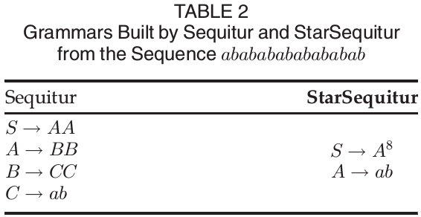
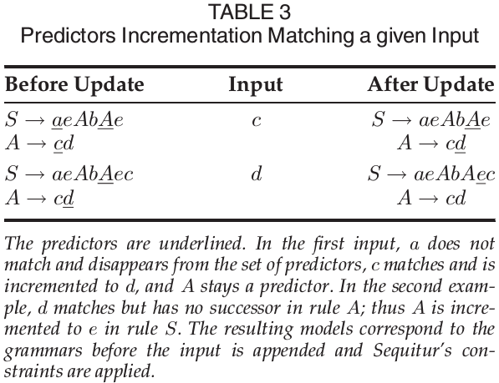
Introduction
The Omnisc'IO Approach
Algorithmic and Technical Description
Evaluation
Related Work
Conclusion
Algorithmic and Technical Description
Most HPC application have a periodic behavior.
A new algorithm StarSequitur stores symbols with an exponent, for instance a³ instead of aaa.
Mark some of the terminal symbols in the grammar as predictors.
A predictor in the grammar represents a position in grammar corresponding to a pattern that Omnisc’IO “thinks” we are currently encountering again.
Updating and discovering predictors are key steps.
For Omnisc’IO to be useful in HPC I/O optimizations, it should be able to predict any N future operations.
Iterators that start at current predictors and read the grammar from them.
At each operation;
Omnisc’IO updates its main grammar, tables of access sizes, offset transformations, interarrival times.
Updates its predictors and builds the set of possible next context symbols.
From these possible next symbols;
Scheduling, prefetching or caching can be improved.
Notes:
Sequitur and StarSequitur build a grammar from a stream of symbols, but they do not predict the next incoming symbols from past observations.

Slide 8
Introduction
The Omnisc'IO Approach
Algorithmic and Technical Description
Evaluation
Related Work
Conclusion
Algorithmic and Technical Description
Context-Aware I/O Behavior.
Tracking Access Sizes
Predicting the next context symbol helps in predicting the next access size.
Omnisc’IO keeps track of all access sizes encountered and builds a grammar from this sequence of sizes.
The sizes constitute the terminal symbols of this local size grammar.
Local size grammar associated with a context symbol is updated whenever the context symbol is encountered
Tracking Offsets
The next operation is likely to start from the offset where the previous one ended.
Fails for applications that use a higher-level library that moves the offset pointer backward or forward to write headers, footers, and metadata.
Offset transformation needed.
Tracking Files Pointers
The prediction of files accessed is done by recording opened file pointers and associating transitions between symbols.
Tracking Interarrival Times.
Keep track of the time between the end of an operation and the beginning of the next one.
Notes:
bookkeeping of per-context access behavior

Slide 9
Introduction
The Omnisc'IO Approach
Algorithmic and Technical Description
Evaluation
Related Work
Conclusion
Evaluation
List of applications to be used while experimenting Omnisc’IO
These applications are real world examples. They are all built for specific purpose.
Test Environment
Nancy site of the French Grid5000
Linux cluster Intel Xeon L5420 nodes (512 cores)
The OrangeFS 2.8.7 parallel file system is deployed on a separate set of 12 Intel Xeon X3440 nodes
20 G InfiniBand network
Application | Field | I/O Method(s)
 |  | HDF5+POSIX
CM1 | Climate | HDF5+MPI-I/O
 |  | HDF5+Gzip
GTC | Fusion | POSIX
Nek5000 | Fluid Dynamics | POSIX
LAMMPS | Molecular Dynamics | POSIX
Notes:
Reason that using such different applications which use different I/O methods, to see how well Omnisc'IO predicts future context symbols based on past observations. Then evaluate the ability of Omnisc'IO to predict the location of next I/O operation and when will it happen.

Slide 10
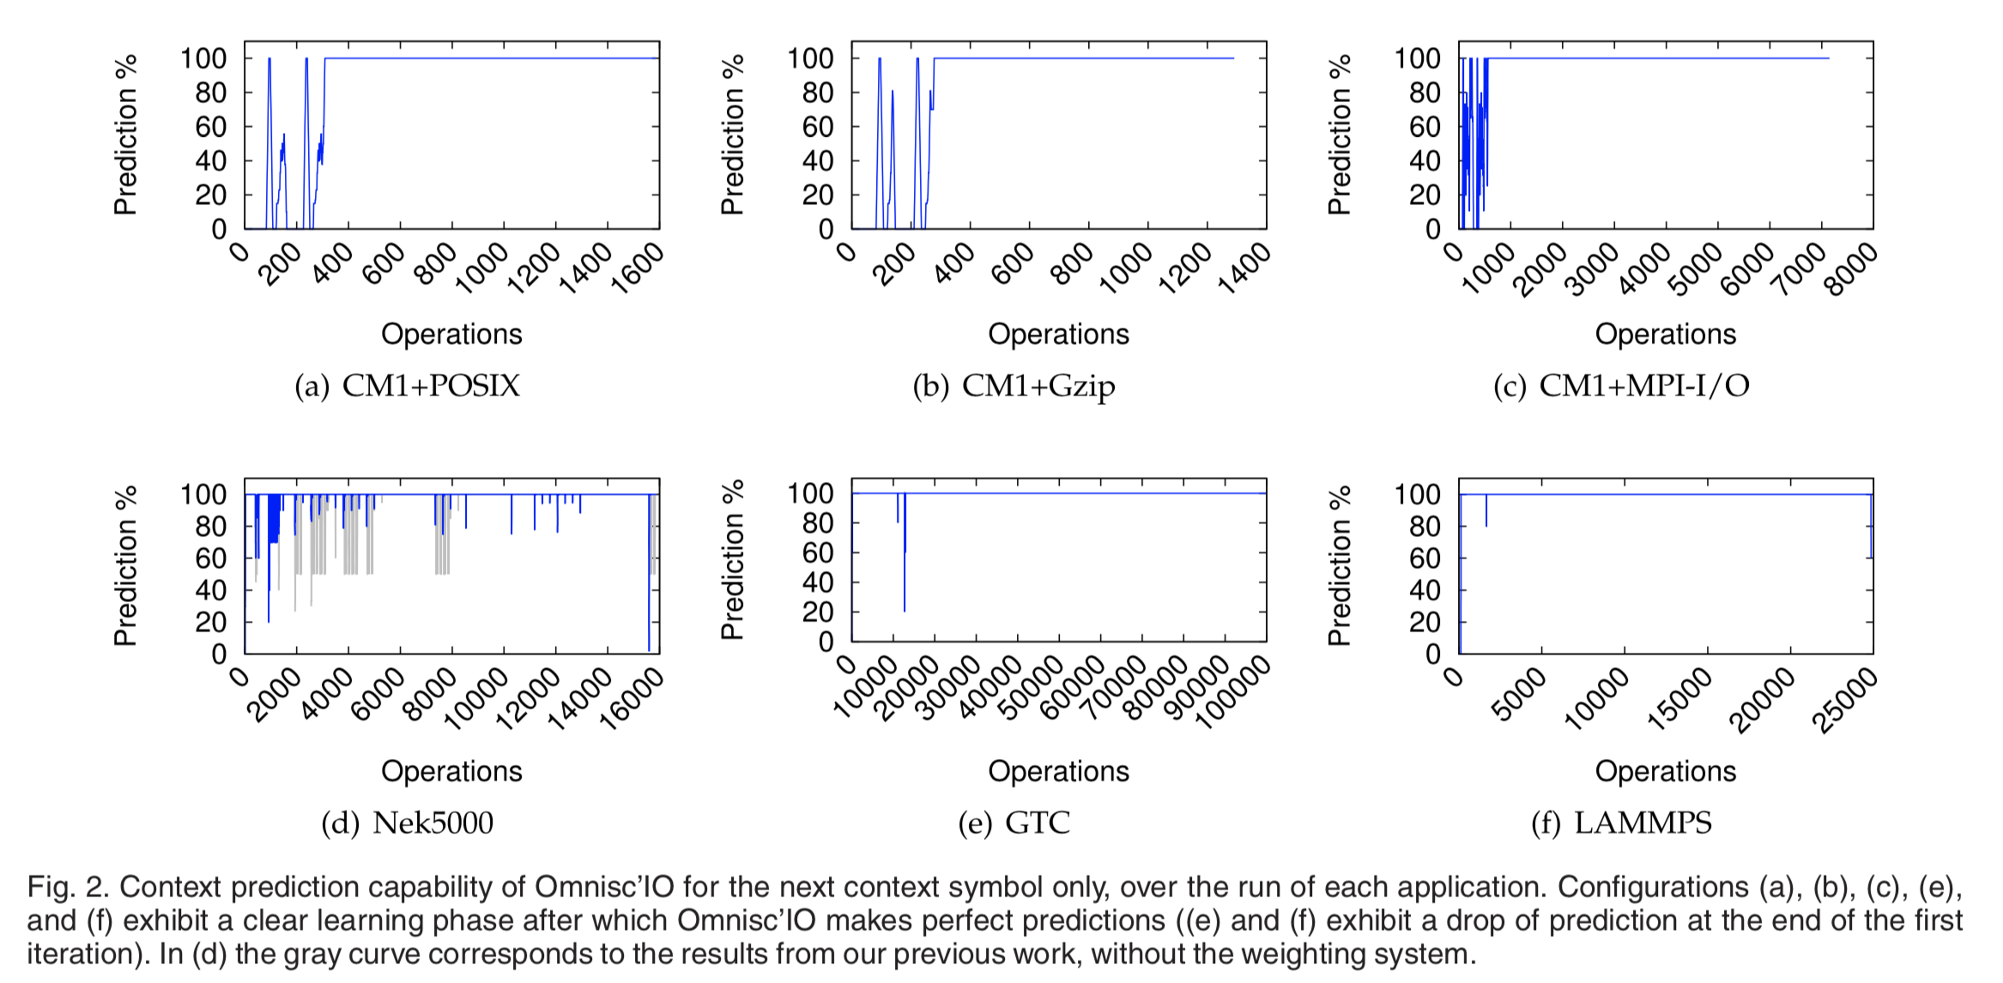
Introduction
The Omnisc'IO Approach
Algorithmic and Technical Description
Evaluation
Related Work
Conclusion
Evaluation
Immediate Context Prediction

Slide 11
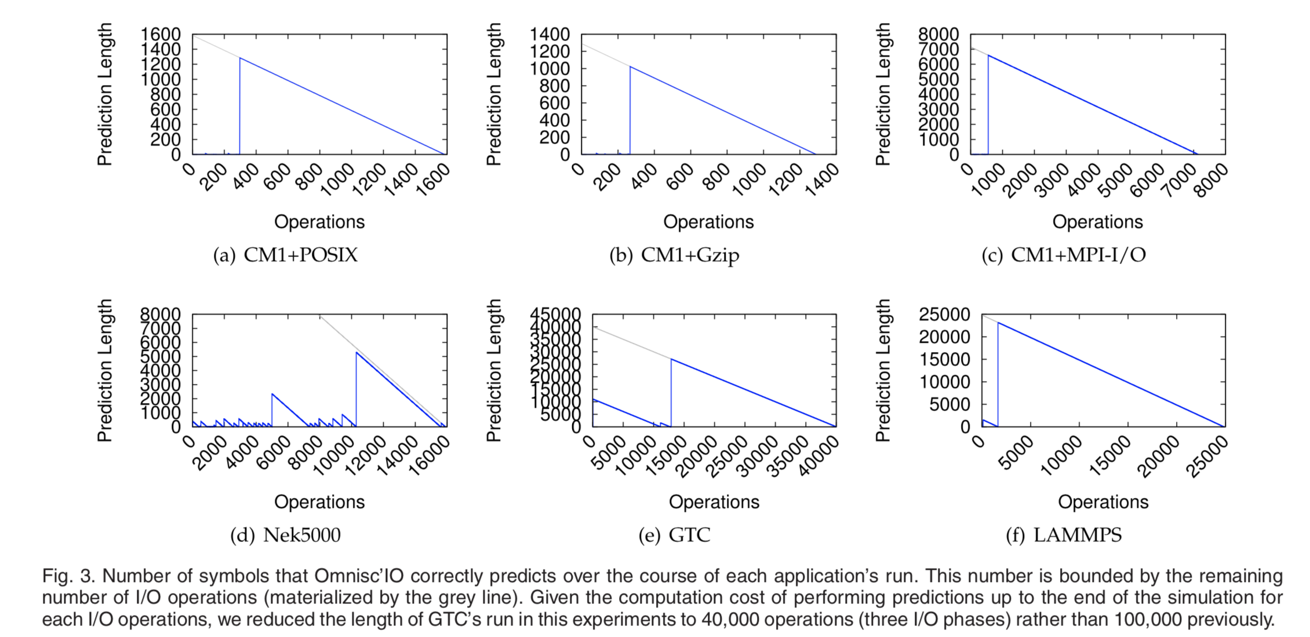
Introduction
The Omnisc'IO Approach
Algorithmic and Technical Description
Evaluation
Related Work
Conclusion
Evaluation
Prediction of N Next Symbols

Slide 12
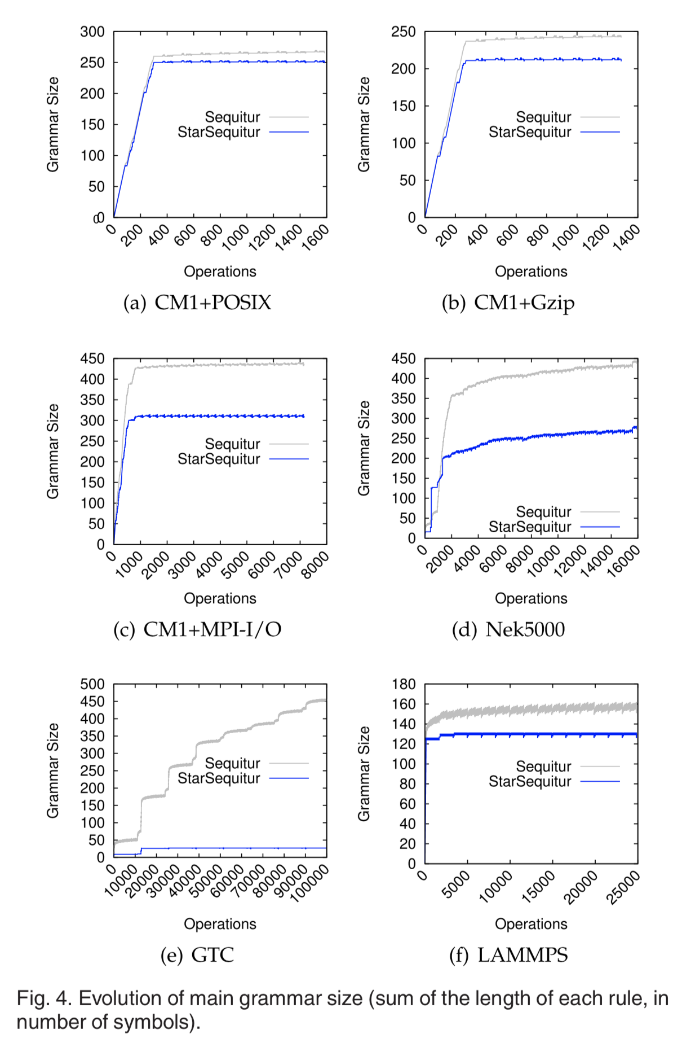
Introduction
The Omnisc'IO Approach
Algorithmic and Technical Description
Evaluation
Related Work
Conclusion
Evaluation
Grammer Size

Slide 13
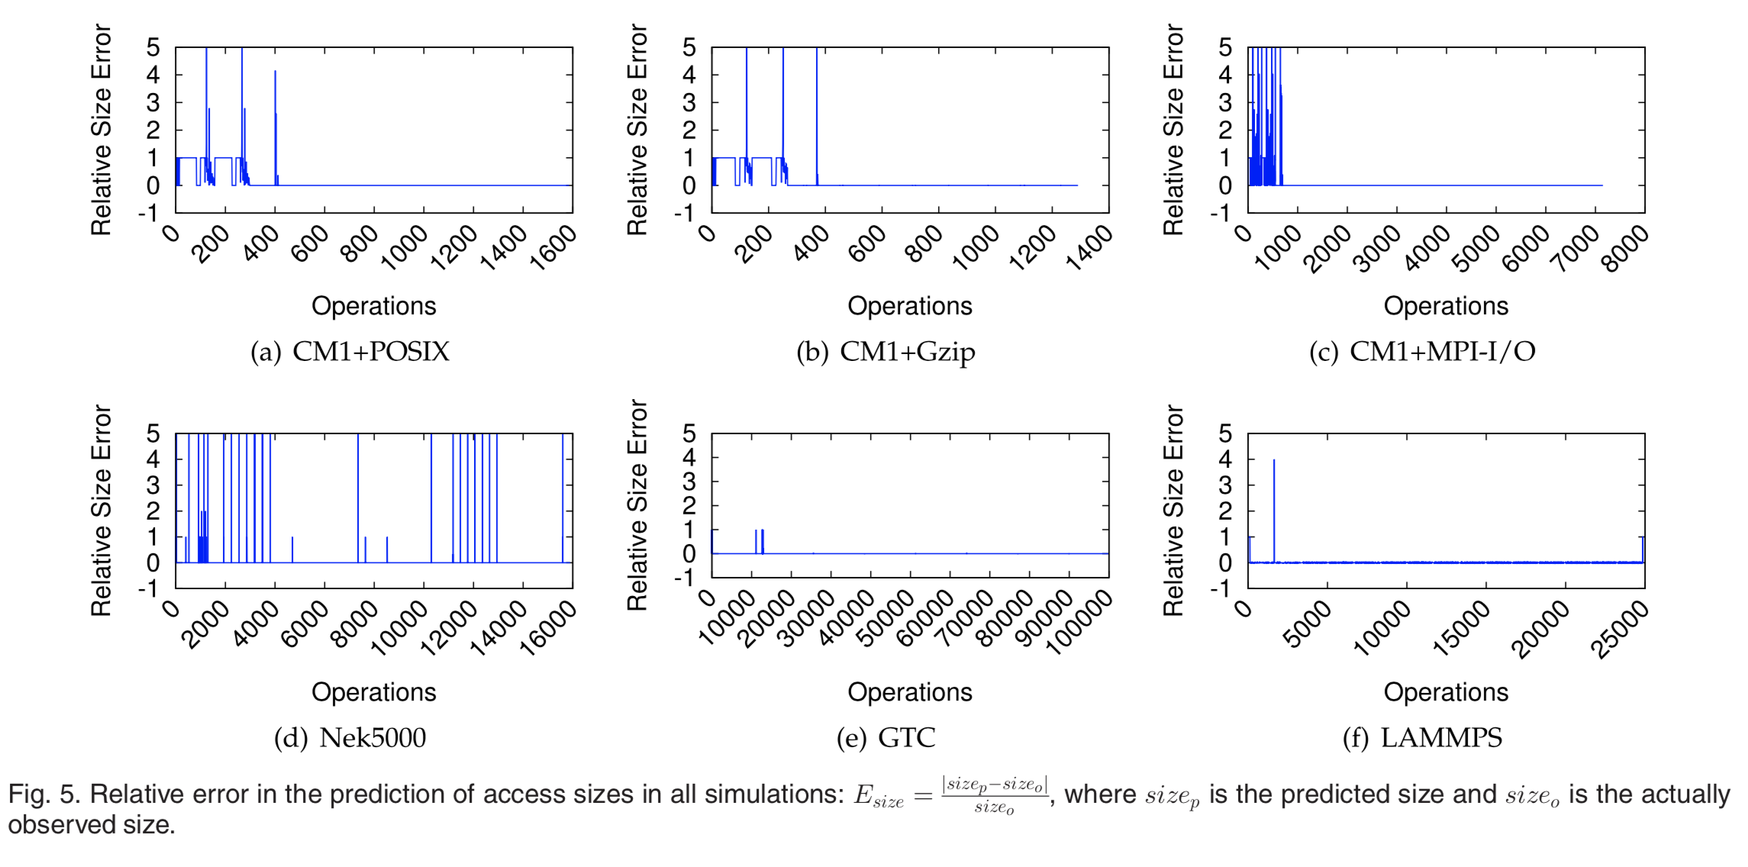
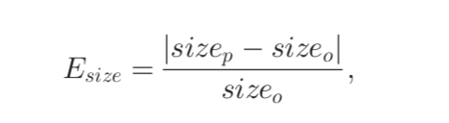
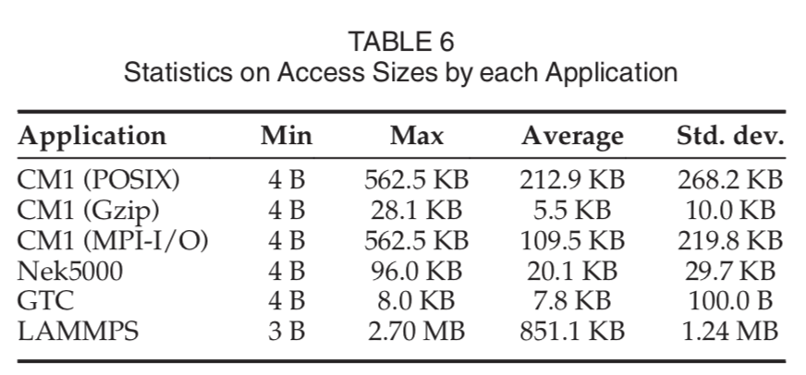
Introduction
The Omnisc'IO Approach
Algorithmic and Technical Description
Evaluation
Related Work
Conclusion
Evaluation
Relative Error

Slide 14
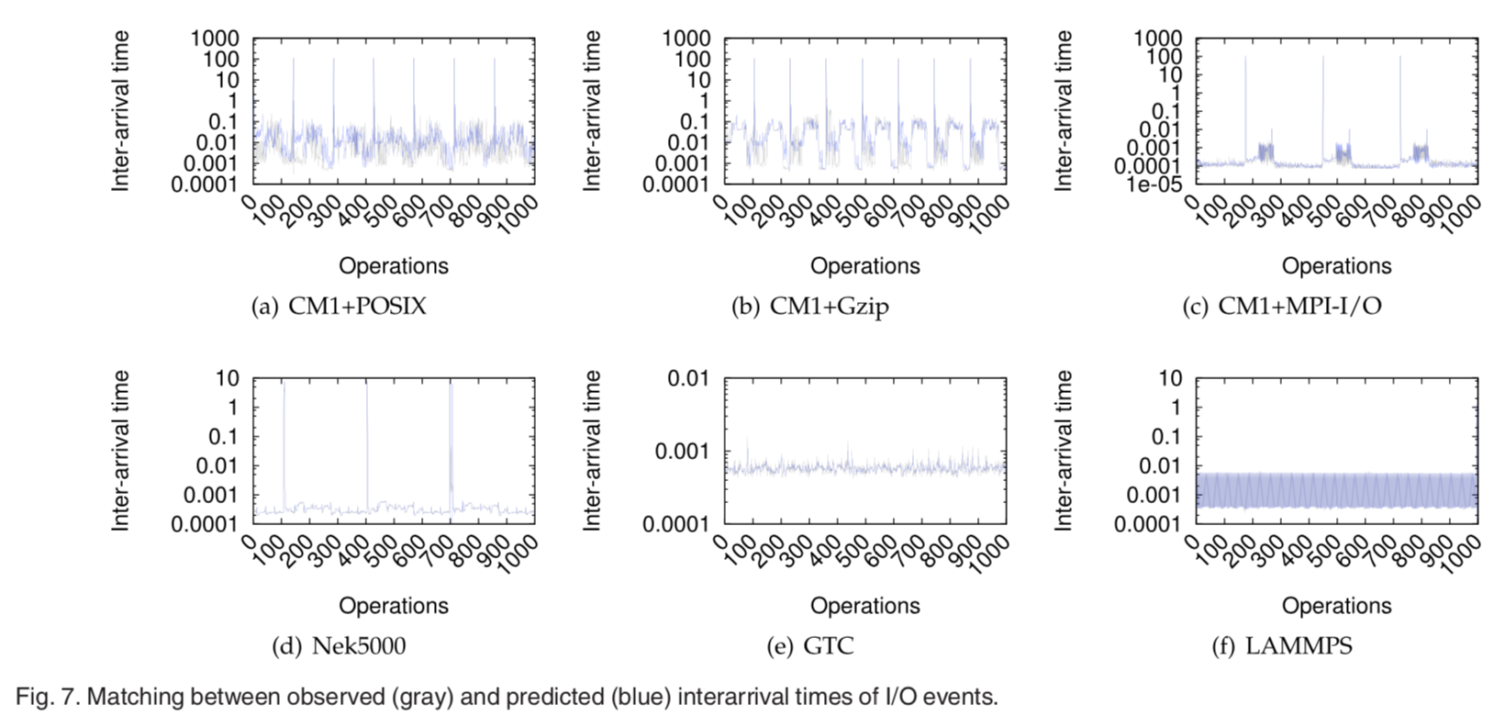
Introduction
The Omnisc'IO Approach
Algorithmic and Technical Description
Evaluation
Related Work
Conclusion
Evaluation
Temporal Prediction -1

Slide 15
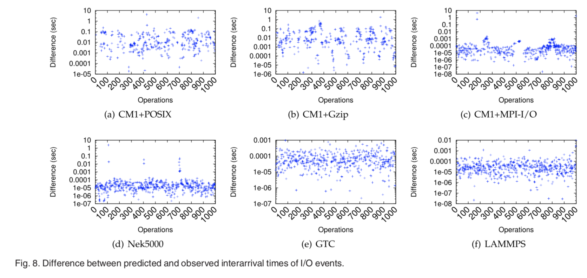
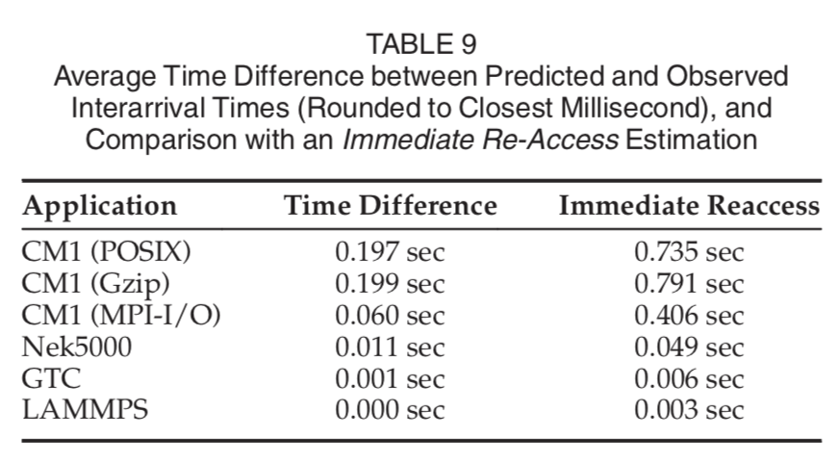
Introduction
The Omnisc'IO Approach
Algorithmic and Technical Description
Evaluation
Related Work
Conclusion
Evaluation
Temporal Prediction -2

Slide 16
Introduction
The Omnisc'IO Approach
Algorithmic and Technical Description
Evaluation
Related Work
Conclusion
Related Work
Grammar-Based Modelling
Sequitur (repetitive periodic I/O)
I/O Patterns Prediction
Spatial Predictions
Gniady (Improve caching)
Madhyastha and Reed (using Artificial Neural Networks
He (improve metadata indexing in PLFS, considers sequence of offset and size, uses LZ77 algorithm)
Temporal Prediction and Scheduling
Tran and Reed (using ARIMA time series)
Byna (can be used in later runs)
Zhang (trend toward smaller operating systems with only restricted features so not applicable in future machines with no preemptive process scheduler)

Slide 17
Introduction
The Omnisc'IO Approach
Algorithmic and Technical Description
Evaluation
Related Work
Conclusion
Conclusion
The unprecedented scale of tomorrow’s supercomputers forces researchers to consider new approaches to data management. In particular, self-adaptive and intelligent I/O systems that are capable of run-time analysis, modeling, and prediction of applications’ I/O behavior with little overhead and memory footprint will be of utmost importance to optimize prefetching, caching, or scheduling techniques.
In this paper presented Omnisc’IO, an approach that builds a model of I/O behavior using formal grammars. Omnisc’IO is transparent to the application, has negligible overhead in time and memory, and converges at run time without prior knowledge of the application. It is based on an extension of Nevill-Manning’s Sequitur algorithm, that called StarSequitur, and is able to make accurate prediction of any N future I/O operations.
As future work, Omnisc’IO to integrate within CALCioM framework for efficient I/O scheduling and to implement prefetching and caching systems that leverage the excellent prediction capabilities shown by Omnisc’IO. There are also another plan to explore this approach as a mechanism for representing I/O behavior for replay in parallel discrete event simulations of large-scale HPC storage systems.

Slide 18
Thank you for your time.
Any questions?

